Slide 1

Fuzzing in the open
Integrate your project in OSS-Fuzz for continuous fuzzing

Slide 2
First things first:
Do you have the setup?
If not, install Python 3 + Docker, and run:
$ git clone https://github.com/google/oss-fuzz
$ git clone http://github.com/iosifache/fuzzingintheopen

Slide 3
Fuzzing 101
OSS-Fuzz
Discovering Heartbleed with fuzzing
Tales from a real-life integration
OSS-Fuzz-Gen
The workshop in a nutshell

Slide 4



Dongge Liu
Working on OSS-Fuzz-Gen
Maintaining OSS-Fuzz and FuzzBench
Research interests in cybersecurity and machine learning
Andrei Iosif
Security engineer @ Snap Inc.
GSoC mentorship, startup advisorship, coffee, and outdoor sports
Ex-member of the Ubuntu Security Team
Jiongchi Yu
PhD candidate in Computer Science at SMU
Working on integrating OpenPrinting projects into OSS-Fuzz (through GSoC)
Research in cloud native testing and security

Slide 5

Fuzzing
A dynamic software testing mechanism that runs (in an instrumented and optimised fashion) the software under test (through its harness) with tailored (eventually random) (formatted or unformatted) (eventually based on an initial corpus) inputs to detect unexpected behaviours such as crashes, assertions, memory leaks, race conditions and undefined behaviours

Slide 6
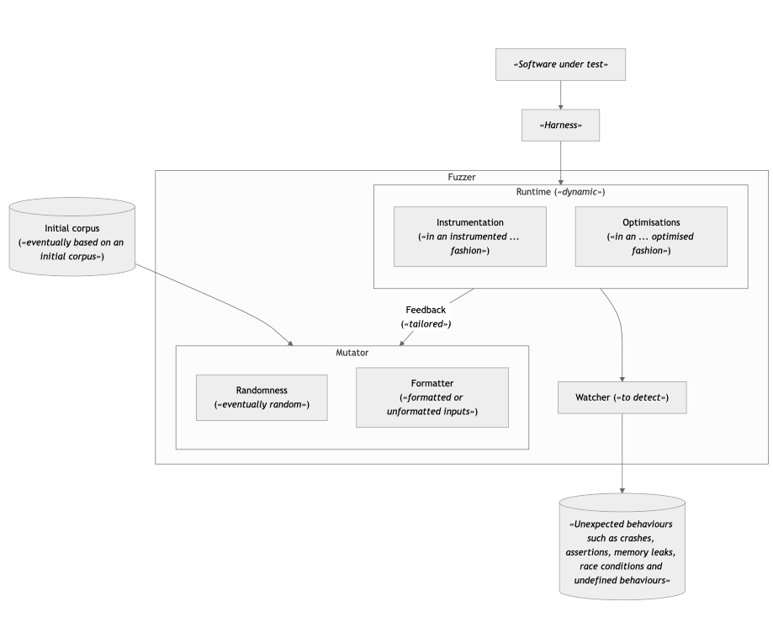

Slide 7


Valid and accepted inputs
Unexpected input
Invalid and rejected inputs

Slide 8
OSS-Fuzz from Google
Continuous fuzzing infrastructure for critical open source projects
Free
OSS-Fuzz has helped identify and fix over 10,000 vulnerabilities and 36,000 bugs across 1,000 projects
Supports:
Multiple fuzzers: libFuzzer, AFL++, Honggfuzz, and Centipede
Multiple languages: C, C++, Go, Java, Javascript, Python, Rust, and Swift
CPU architectures: x86_64, i386
Notes:
OSS-Fuzz was launched in 2016 in response to the Heartbleed vulnerability.
At the time, fuzzing was not widely used, and required extensive manual effort and CPU power.
Google created OSS-Fuzz to fill this gap: it’s a free service that runs fuzzers for open source projects and privately alerts developers to the bugs detected.
Since its launch, OSS-Fuzz has become a critical service for the open source community, growing beyond C/C++ and can detect problems in memory-safe languages such as Go, Rust, and Python.

Slide 9
OSS-Fuzz Rewards
Some contributions are rewarded (up to 15k) by Google:
Integrations: initial or ideal
Coverage: line coverage, FuzzIntrospector, or FuzzBench
Vulnerabilities: new sanitisers or finding impactful vulnerabilities
Notes:
We also love to reward people for their contributions to the open source community.
There are 3 main types of rewards, integration, coverage, and vulnerability.
We give an initial integration rewards to people integrate a new critical open source project to OSS-Fuzz, and an ideal integration reward for fuzz targets that satisfy certain criteria
We also give rewards if people can improve the coverage of a fuzz target, or vulnerability rewards for new sanitizers of discovery of impactful vulnerabilities.

Slide 10


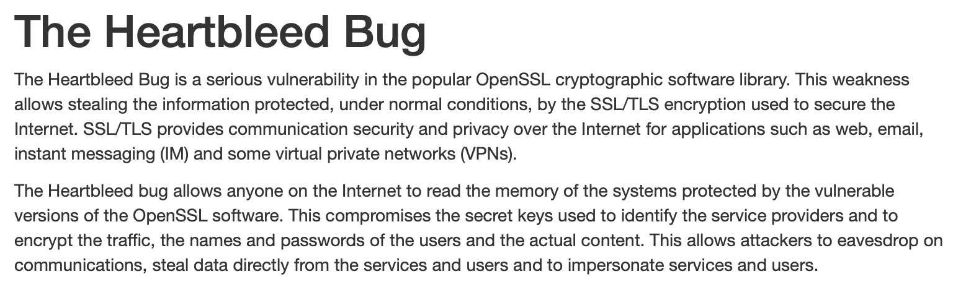

Slide 11
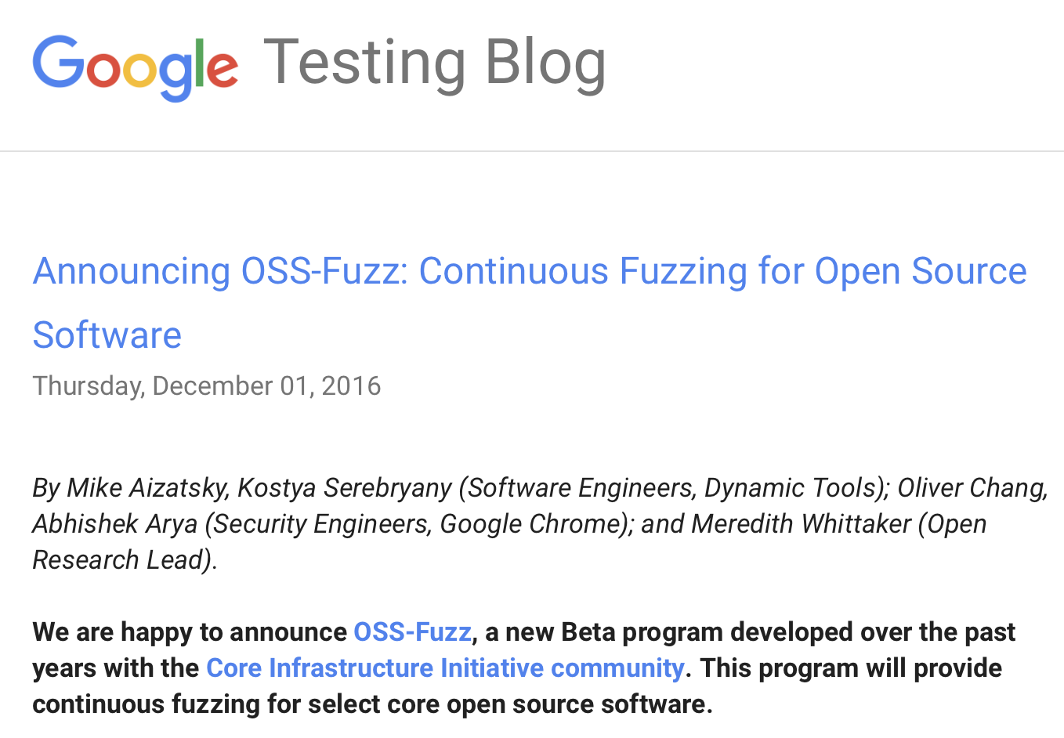


Slide 12
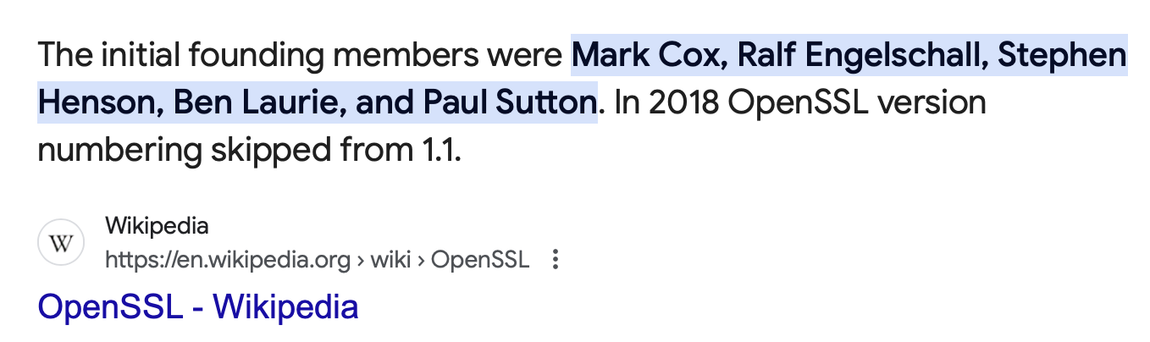
Assuming you are
, use OSS-Fuzz to detect

Slide 13
*Some steps are infeasible for a 1.5-hours workshop.
PRACTICAL
vs.
PLACEHOLDER
practical steps of the OSS-Fuzz integration vs. just-described steps (blocked by external factors)

Slide 14
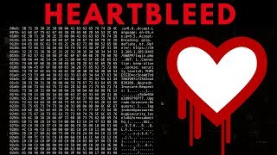

Slide 15
Initialising the project
PRACTICAL

Slide 16
host $ cd oss-fuzz
host $ export PROJECT_NAME=openssl-heartbleed
host $ export LANGUAGE=c++
host $ python infra/helper.py generate \
$PROJECT_NAME \
--language=$LANGUAGE
host $ cd projects/$PROJECT_NAME
host $ ls

Slide 17
Generating SSL certificates
PLACEHOLDER

Slide 18
host $ openssl req -x509 \
-newkey rsa:512 \
-keyout server.key \
-out server.pem \
-days 9999 \
-subj /CN=a/ \
-nodes

Slide 19
Filling up project.yaml
PRACTICAL

Slide 20
host $ cat project.yaml
host $ mv ../../../fuzzingintheopen/infra/project.yaml .
host $ cat project.yaml

Slide 21
Filling up Dockerfile
PRACTICAL

Slide 22
host $ cat Dockerfile
host $ mv ../../../fuzzingintheopen/infra/Dockerfile .
host $ cat Dockerfile

Slide 23
Filling up build.sh
PRACTICAL

Slide 24
host $ cat build.sh
host $ mv ../../../fuzzingintheopen/infra/build.sh .
host $ cat build.sh

Slide 25
Tips
Don’t overwrite CFLAGS or CXXFLAGS.

Slide 26
Creating a harness in target.cc
PRACTICAL

Slide 27
host $ mv ../../../fuzzingintheopen/infra/runtime .
host $ ls runtime
host $ mv ../../../fuzzingintheopen/infra/target.cc .
host $ cat target.cc

Slide 28
Tips
Maintain the fuzz target target.cc in the project-under-test repository

Slide 29
Verifying the files’ correctness
PRACTICAL

Slide 30
host $ docker build -t fuzzingintheopen .
host $ docker run -it -v "$(pwd)/out":/out fuzzingintheopen /bin/bash
docker $ /src/build.sh
docker $ /out/openssl-fuzzer

Slide 31
Building the fuzzers
PRACTICAL

Slide 32
host $ cd ../../
host $ python infra/helper.py build_fuzzers \
--sanitizer address \
--engine libfuzzer \
--architecture <x86_64|i386|aarch64> \
$PROJECT_NAME

Slide 33
Running the fuzzer (and profit!)
PRACTICAL

Slide 34
host $ export FUZZER_NAME=openssl-fuzzer
host $ python infra/helper.py run_fuzzer \
--sanitizer address \
--engine libfuzzer \
--architecture <x86_64|i386|aarch64> \
$PROJECT_NAME \
$FUZZER_NAME
host $ xxd ./build/out/heartbleed/crash-*

Slide 35
Validating the crash
PRACTICAL

Slide 36
host $ python infra/helper.py reproduce \
$PROJECT_NAME \
$FUZZER_NAME \
<crash_file>
host $ ./build/out/openssl-fuzzer <crash_file>

Slide 37
Hosting the harness in OSS-Fuzz
PLACEHOLDER

Slide 38
Hosting the harness in OSS-Fuzz
We’ll review the fuzz folder from the OpenSSL repository:
https://github.com/openssl/openssl/tree/master/fuzz
Tip: Don’t place the harnesses in the OSS-Fuzz repository.

Slide 39
Having a PR accepted inside the OSS-Fuzz repo
PLACEHOLDER

Slide 40
Having a PR accepted inside the OSS-Fuzz repo
The initial integration PR of project Pacemaker is a good example:
Describe Project purpose and importance.
List major users.
Highlight critical role of the project.
Link maintainer's approval and fuzz target PR.
Tip: Addressing these points helps our panel decide on accepting your integration.
Notes:
We expect the PR to:
Briefly explain what your project does and its significance.
Mention key organizations or applications that rely on your project.
In particular, Emphasize how the project is essential to its users or ecosystem.
Provide links to the maintainer's approval and your fuzz target PR.

Slide 41
Checking the remote build logs
PLACEHOLDER

Slide 42
Checking the remote build logs
The latest build logs are linked in Fuzz Introspector’s UI:
https://introspector.oss-fuzz.com/project-profile?project=openssl
They can also fail, as illustrated here:
https://issues.oss-fuzz.com/issues/42533795
Try to spot the issue in the logs.

Slide 43
Checking the Fuzz Introspector page
PLACEHOLDER

Slide 44
Checking the Fuzz Introspector page
Access the Fuzz Introspector page of OpenSSL:
https://introspector.oss-fuzz.com/project-profile?project=openssl
What’s the line coverage of the project? What functions can be fuzzer to increase the coverage?

Slide 45
Receiving a mail with a crash
PLACEHOLDER

Slide 46
Receiving a mail with a crash
Use https://issues.oss-fuzz.com/issues/42535311 as an example.

Slide 47
Patching
PRACTICAL

Slide 48
Patching
Inspect the infra/heartbleed.patch Git patch.
Modify Dockerfile to apply the patch after cloning the openssl repository.
Rebuild.
Fuzz again with OSS-Fuzz.

Slide 49
A success story: GSoC x OpenPrinting x OSS-Fuzz
GSoC has helped in securing OpenPrinting with integrating unit testing and CI testing of OpenPrinting projects, e.g. OpenPrinting/libcupsfilters#58
Previous OSS-Fuzz integrations of OSS projects during GSoC: nginx, PostgreSQL, and Envoy Proxy in 2020

Slide 50

OpenPrinting
OpenPrinting is an open source organisation focused on standardizing printing support for Linux and Unix-like systems by providing drivers, filters, and printing tools.
20 out of 37 OpenPrinting projects are mainly implemented in memory unsafe languages (C or C++).
OpenPrinting projects lacks sufficient fuzz testing.

Slide 51
OpenPrinting Security
Many widely used software is developed based on OpenPrinting projects, e.g, GTK, Gnome, and LibreOffice.
Projects from OpenPrinting are pre-installed in Ubuntu releases.
Security issues in OpenPrinting projects can cause severe consequences, for example CVE-2024-47175, CVE-2024-47176, CVE-2024-47176, and CVE-2024-47177, which leads to the remote code execution (RCE).

Slide 52
Integrating OpenPrinting Projects into OSS-Fuzz
Three main projects in OpenPrinting
cups
libcups
cups-filters
Pending projects
cups-filters
libcupsfilters
cups-browsed

Slide 53
Integrating OpenPrinting Projects into OSS-Fuzz
Our progress
41 issues reported with 21 resolved
5000+ LoC changes
Enabling Fuzz Introspector to support LLM-assisted fuzz driver generation (via OSS-Fuzz-Gen).
Advanced fuzz integration
From unit testing to fuzz harness
Adapting various of test input format (e.g., IPP Protocol, PDF file, and argv input)
Feedback from Fuzz Introspector to OSS-Fuzz-Gen
Refer to our repo: https://github.com/OpenPrinting/fuzzing

Slide 54
OSS-Fuzz-Gen
Given a function, automatically generates fuzz targets.
 | Human-written | OSS-Fuzz-Gen
Fuzzing knowledge | Some required | LLM pretrained
Project domain knowledge | Required | Programmatically supplied in prompts
Time | Hours-Days | Seconds
Cost | $1000+ | $0.1-
Notes:
Recall that OSS-Fuzz was created to reduce the extensive manual effort in fuzzing, but writing good fuzz targets still requires developers
1. to learn background knowledge about fuzzing,
2. to read the project source code to obtain domain knowledge of a project beforehand, and
3. it takes hours if not days to write and refine a good fuzz target.
OSS-Fuzz-Gen aims to further free developers from these burdens. LLMs are pre-trained with fuzzing knowledge so we developers don't have to learn everything. The domain knowledge of the project under test will be programmatically parsed and supplied to LLM via prompts, so developers do not have to read them everytime. Each generation will only take seconds and it won't be more expensive than a few LLM queries.

Slide 55
OSS-Fuzz-Gen Trophies
Uncovered 26 new bugs (e.g., CVE-2024-9143) in projects were previously thoroughly fuzzed with tons of CPU hours
Contact us to apply OSS-Fuzz-Gen to a new project or apply your ideas to it.
Project | Bug Type
cJSON | OOB read
libplist | OOB read
hunspell | OOB read
zstd | OOB write
gdbm | Stack buffer underflow
hoextdown | Use of uninitialised memory
pjsip | OOB read
pjsip | OOB read
gpac | OOB read
gpac | OOB read/write
gpac | OOB read
gpac | OOB read
sqlite3 | OOB read
Project | Bug Type
htslib | OOB read
libical | OOB read
croaring | OOB read
openssl | OOB read/write
Undisclosed | OOB read
Undisclosed | OOB read
Undisclosed | OOB read
Undisclosed | OOB read
Undisclosed | OOB read
Undisclosed | Use after free
Undisclosed | Use of uninitialised memory
Undisclosed | Java RCE
Undisclosed | Java Regexp DoS
Notes:
To date, OFG has uncovered 26 bugs from these projects, and increased the code coverage of many more.
Note that these projects were previously fuzzed for tens of thousands of CPU hours, but OFG can still manage to find new bugs.
Next year, OSS-Fuzz-Gen will be gradually roll out to more projects in OSS-Fuzz officially.
If you'd like to be among the first to experience its features, please come and talk to us!

Slide 56
OSS-Fuzz-Gen Overview
Function signature
+ Enriched project context
+ Interactive access to project build environment (Bash/LLDB)
Existing projects C/C++, Java, Python
OSS-Fuzz
OSS-Fuzz-Gen
LLM
Fuzz target source code
build script
Build and fuzz
Diagnose:
Compilation errors
Runtime crashes
False positive crashes
Low coverage fuzz targets
Raw logs from compilation & runtime
Refined fuzz targets source code + build script
Build and evaluate
Notes:
Here is a simplified workflow in case you are curious about how it works
It involves two phases: fuzz target generation and fuzz target refinement.
In the generation phase, it selects a function from OSS-Fuzz, parses and supplies the context info to LLM to generate a fuzz target, then builds and executes the target via OSS-Fuzz infra.
This phase correspond to the first two rows of the diagram
If there is an error when compiling or running the fuzz target, the refinement phase kicks in, which is illustrated by the bottom two rows.
In this phase, the framework automatically parses these errors and their contextual info, then feed them to LLM via prompts to query a refined fuzz target.
This allows it to iteratively and automatically improve the fuzz target.

Slide 57
Fuzzing 101
OSS-Fuzz
Discovering Heartbleed with fuzzing
Tales from a real-life integration
OSS-Fuzz-Gen
The workshop in a nutshell
Notes:
The (duplicated) slide plays the role of a wrap-up of all the things that were discussed/done.

Slide 58

Notes:
Ask for additional questions related to any topic that was discussed.

